Slide 1

HemoCare: Blood Donation Management
HemoCare is a cutting-edge web-based system streamlining blood donation processes. It empowers donors, optimizes blood bank operations, and enhances overall healthcare efficiency. This innovative platform connects donors with blood banks seamlessly, ensuring a steady supply of life-saving blood.

Slide 2

Simplified Donor Registration
1
Personal Information
Donors input basic details like name, contact number, email-id, age, gender, and address. The interface is user-friendly and accessible on various
devices.
2
Medical Data
Blood group, hemoglobin levels, and last donation date are entered. The system validates this information against eligibility criteria.
3
Location Capture
Using Geolocation API, HemoCare pinpoints the donor's location. This data aids in connecting donors with nearby receivers.

Slide 3

Smart Eligibility Verification
Gender-Based Validation
HemoCare automatically checks hemoglobin levels against gender-specific thresholds. This ensures accurate eligibility assessment for each donor.
Real-Time Alerts
The system immediately notifies users of their donation eligibility. This prevents ineligible donors from proceeding further.
Dynamic Blood Group Selection
Available blood groups are loaded from the database. This ensures up-to-date information on needed blood types.

Slide 4
Location-Based Services
Geolocation Integration
Interactive Mapping
HemoCare captures donor locations using the Geolocation API. This feature enables precise tracking of donor distribution.
Google Maps API integration allows donors to view their location. They can easily find nearby blood banks and donation camps.

Slide 5




Robust Tech Stack
Frontend
HTML, and CSS create a responsive, user-friendly interface. JavaScript adds interactivity and dynamic content.
Backend
PHP handles form submissions and data processing. MySQL efficiently stores and manages donor and blood group data.
API Integration
Google Maps API powers location services. This enables accurate mapping and geolocation functionalities.

Slide 6

Benefits for Stakeholders
Donors
Easy registration, real-time eligibility checks, and location services
Blood Banks
Efficient donor management, optimized blood collection, and improved inventory control
Healthcare System
Increased blood supply, faster emergency response, and better patient care
Community
Enhanced awareness, increased donation rates, and improved health outcomes

Slide 7

HemoCare: Saving Lives Through Innovation
1
Efficiency Boost
2
Enhanced User Experience
HemoCare streamlines blood donation processes, reducing administrative burden and wait times. This leads to increased donation rates and better resource allocation.
The user-friendly interface and smart features make donating blood easier than ever. This encourages regular donations and builds a loyal donor base.
3
Data-Driven Decision Making
4
Community Impact
HemoCare connects receivers with eligible donors—males with donations over 3 months ago and females over 4 months—ensuring health and efficient blood distribution.
By simplifying the donation process, HemoCare helps save more lives. It fosters a culture of regular blood donation in communities.

Slide 8
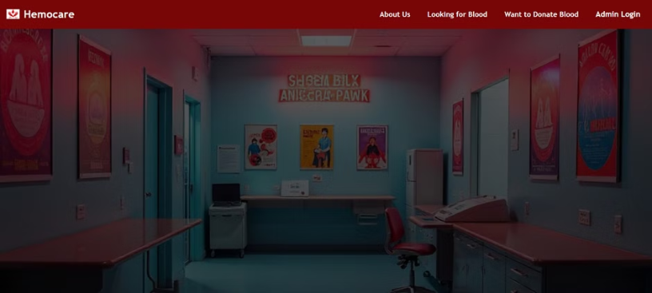
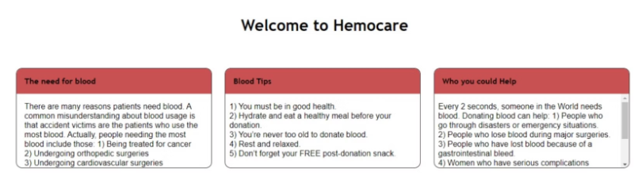
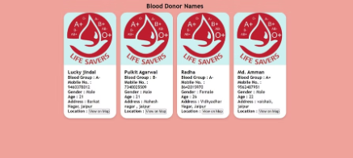
Project Demo
User Interface (UI)

Slide 9
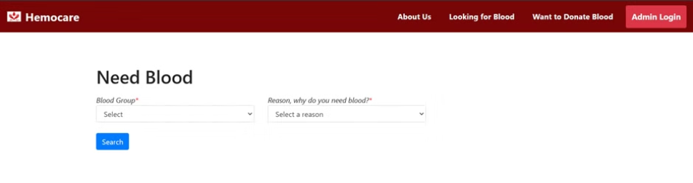
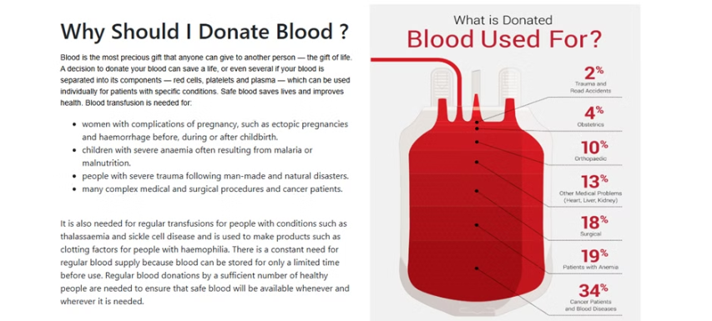
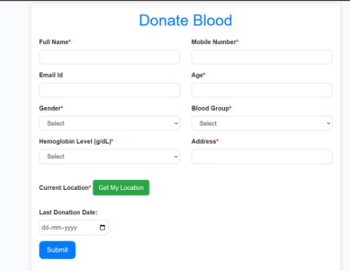
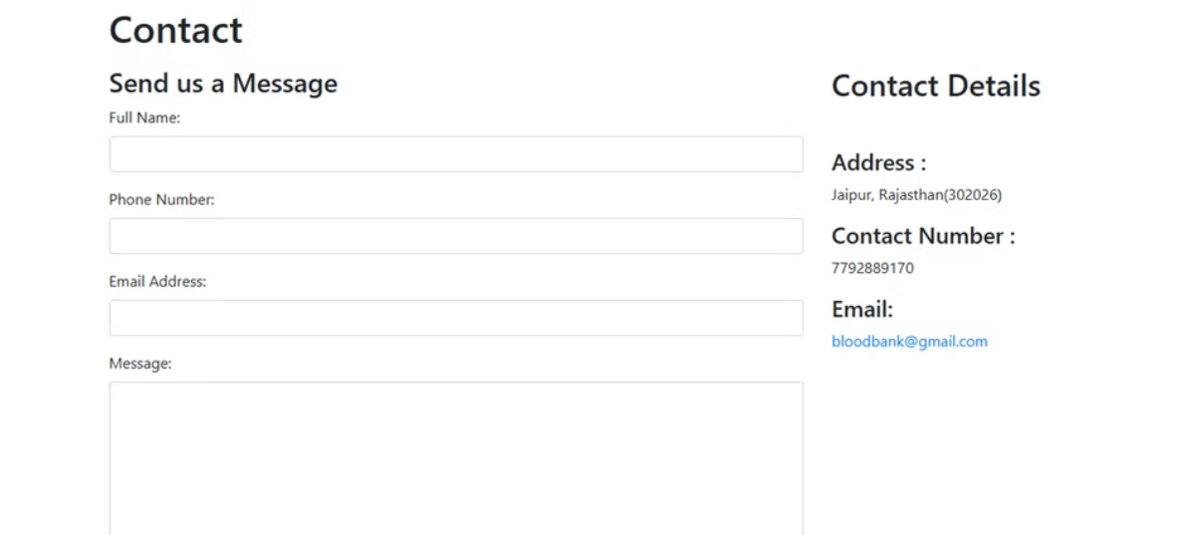

Slide 10
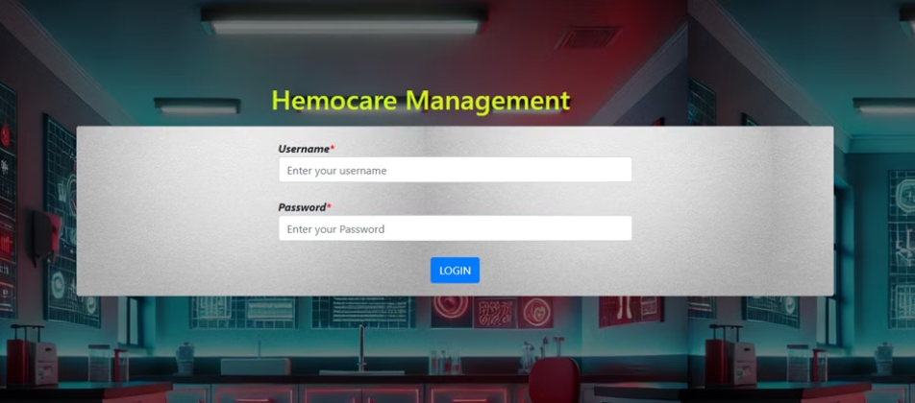
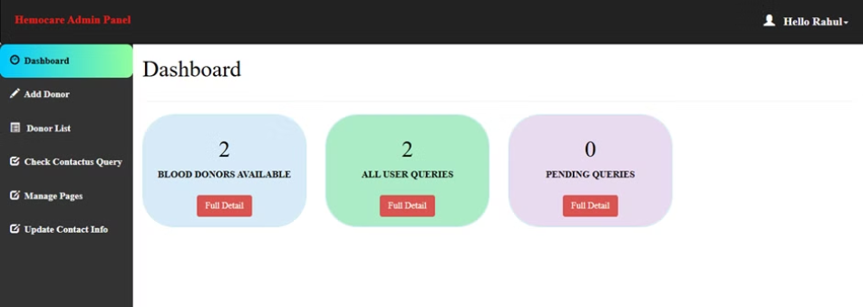
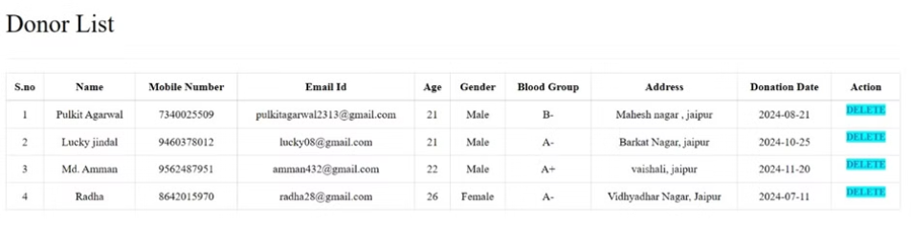
Admin Panel

Slide 11
